Slide 1
“CITY WITHOUT CRIME”
Submitted in partial fulfillment of the requirements for the award of the Degree of
Bachelor of Technology
In
Computer Science and Engineering
Submitted by
Saikat Das
1105206
Under the guidance of
HPES, INDIA.

Slide 2
ABSTRACT
This project is aimed at creating a web application that focuses on lodging complains by victims
The systems will maintain a secure data base where data can stored or fetched from.
These systems enhance the ability of law professionals to coordinate care by providing a victim’s case information and visit history at the place and time that it is needed.

Slide 3
Introduction
This website is an integrated crime management system that is deployed on a 2 tier architecture methodology.
this includes a GUI where the users are provided with there respective activities and a physical layer consisting of the database
The basic designing is done by HTML, CSS and Javascript whereas the backend is a combination of PHP-Mysql.

Slide 4
Objective
The system allows the administrators to register the victim’s case details and the police administer the needs of the victims. The system has to keep data in secure place and controls who can reach the data in certain circumstances

Slide 5
Project planning
Functional Requirements
Non functional requirements
First Information Report.
Missing Person Report.
Anonymous Report.
Check case status.
Admin Login.
Minimum Speed of 144Kbps.
Backend password protected.
Compatible with any O.S with internet connectivity.
New modules can be easily incorporated

Slide 6
Project planning(contd.)
In this section the victim is reqired to fill in the necessary detail regarding name, age, address, id proof, etc. If the user does not fill in any mandatory section then he is asked to do so with an error message.
All the data is then stored into the
database
First Information Report.
Missing Person Report.
Anonymous Report.
Check case status.
Admin Login.

Slide 7
Project planning(contd.)
In this section is aimed at filling a missing persons report by using the name, age , id mark, last seen address etc. and by uploading a recent picture of the victim, which are all uploaded or stored into the database, making it available for the police department.
First Information Report.
Missing Person Report.
Anonymous Report.
Check case status.
Admin Login.

Slide 8
Project planning(contd.)
In this section the victim is required to fill in the necessary detail regarding date, details and photo of the person the victim wants to file a report against, anonymously, i.e., without giving his or her own detail.
First Information Report.
Missing Person Report.
Anonymous Report.
Check case status.
Admin Login.

Slide 9
Project planning(contd.)
Whenever a user files a report, he/she is provided with a case id which the user can use in this section to check whether his case is on going or solved.
First Information Report.
Missing Person Report.
Anonymous Report.
Check case status.
Admin Login.

Slide 10
Project planning(contd.)
In this section the admin(police officer in this case) can log in with the help of a id and password which will be provided to them by the department and the database is update accordingly and manually.
First Information Report.
Missing Person Report.
Anonymous Report.
Check case status.
Admin Login.

Slide 11
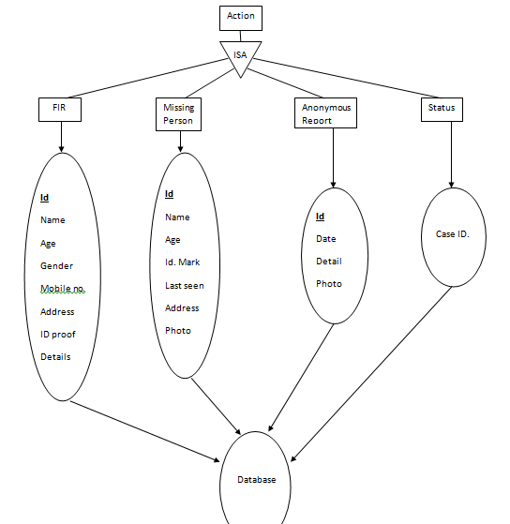
Entity Relationship Diagram

Slide 12
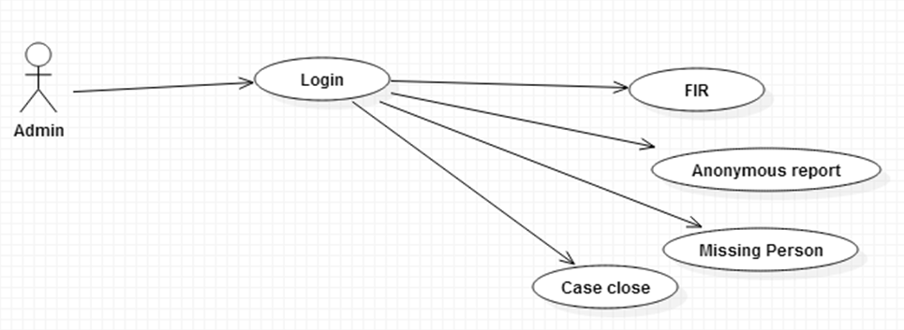
Use Case Diagram

Slide 13
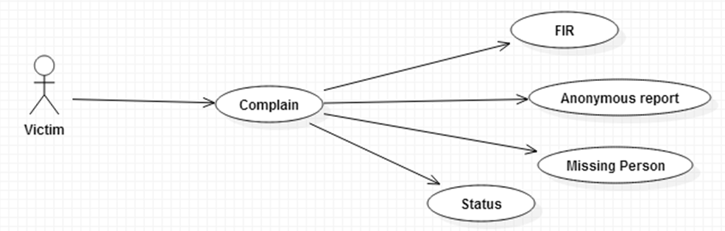
Use Case Diagram(contd.)

Slide 14
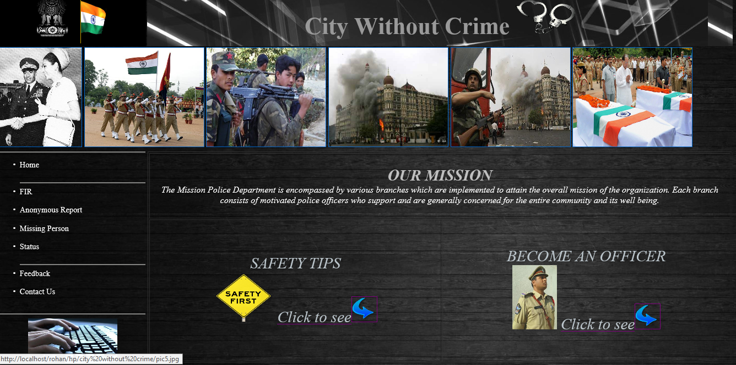
Screenshots

Slide 15
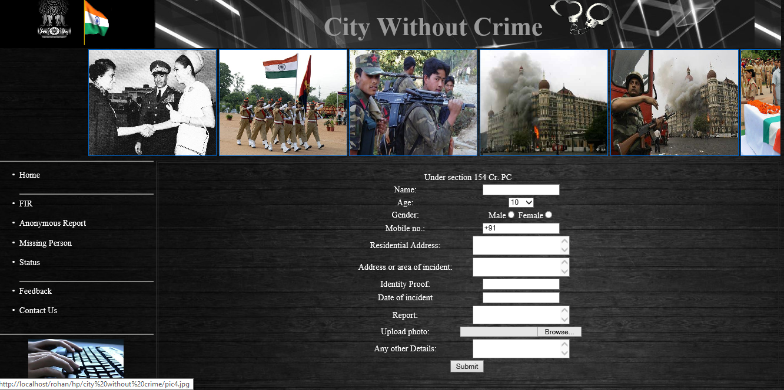
Screenshots(contd.)

Slide 16
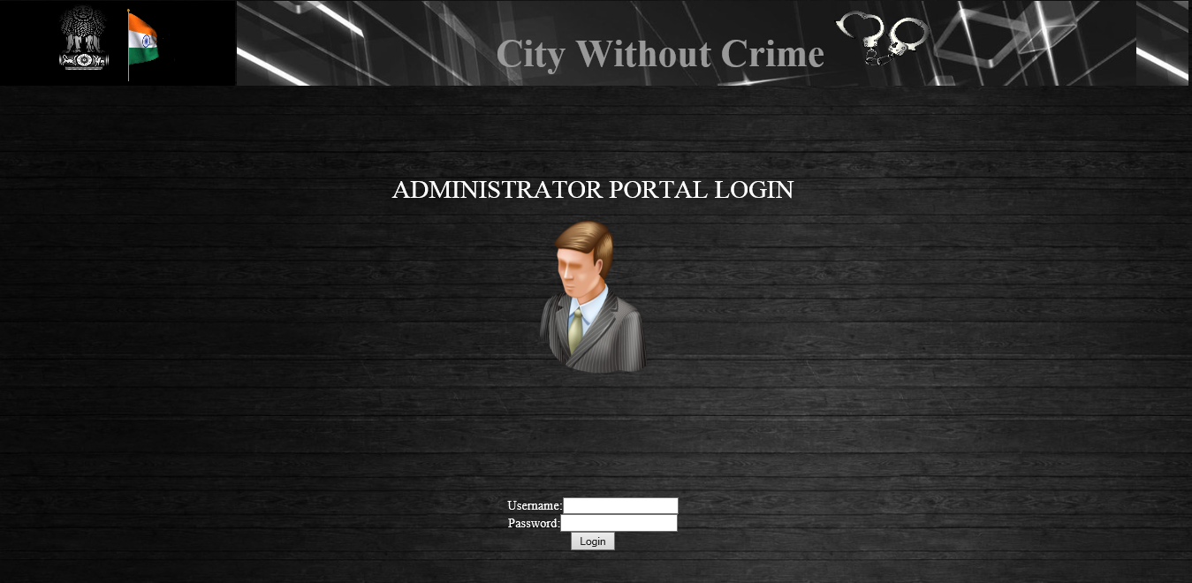
Screenshots(contd.)

Slide 17
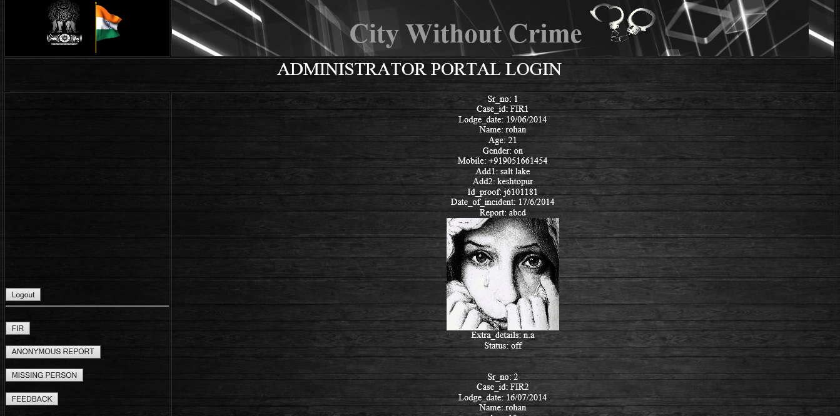
Screenshots(contd.)

Slide 18
Conclusion
This website was successfully created for the effective and user friendly way to lodge complains and for proper administration purpose of the case. The main objective of this website is welfare of the society and to evade the harmful factors of the society causing damage to humanity. This endeavor of ours if deployed globally may eradicate crime in many ways.

Slide 19
THANK YOU

